Slide 1
Floating point representation

Slide 2
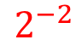
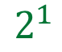
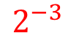
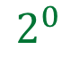
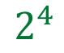
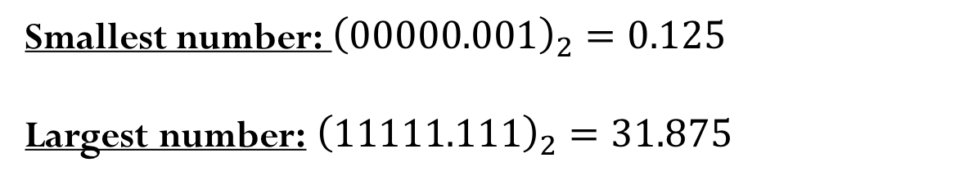
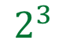
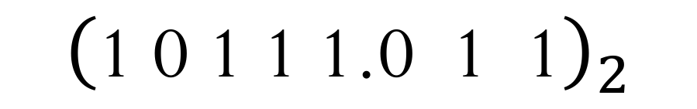
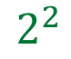
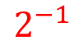
(Unsigned) Fixed-point representation
The numbers are stored with a fixed number of bits for the integer part and a fixed number of bits for the fractional part.
Suppose we have 8 bits to store a real number, where 5 bits store the integer part and 3 bits store the fractional part:
$${\left(\text{1} \text{0} \text{1} \text{1} \text{1.0} \text{1}\text{ 1}\right)}_{2}$$
$$2^{4}$$
$$2^{3}$$
$$2^{2}$$
$$2^{1}$$
$$2^{0}$$
$$2^{−1}$$
$$2^{−2}$$
$$2^{−3}$$
Smallest number: ${\left(\text{00000.}001\right)}_{2}=0.125$
Largest number: ${\left(\text{11111}\text{.}\text{1}11\right)}_{2}=31.875$

Slide 3
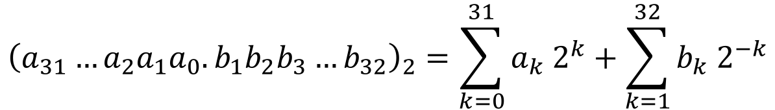
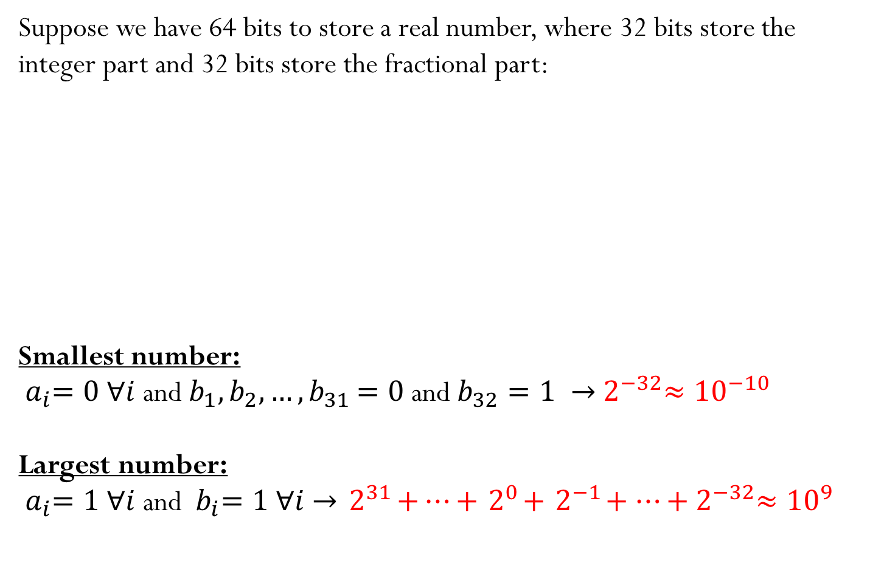
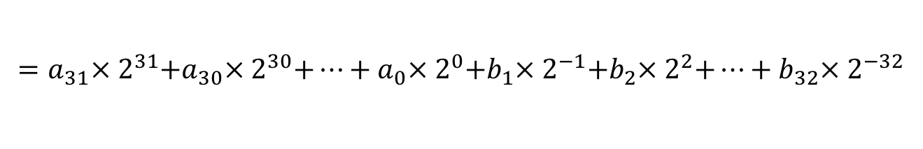
(Unsigned) Fixed-point representation
Suppose we have 64 bits to store a real number, where 32 bits store the integer part and 32 bits store the fractional part:
Smallest number:
${ a}_{i}=0 ∀i$ and $b_{1},b_{2}, …{,b}_{31}=0$ and $b_{32}=1 →{ 2}^{−32}≈{10}^{−10}$
Largest number:
${ a}_{i}=1 ∀i$ and ${ b}_{i}=1 ∀i$ $→{ 2}^{31}+…+{ 2}^{0}+{ 2}^{−1}+…+{ 2}^{−32}≈{10}^{9}$
$${\left(a_{31}…a_{2}a_{1}a_{0}.b_{1}b_{2}b_{3}…b_{32}\right)}_{2}=\sum_{k=0}^{31}{a_{k}{ 2}^{k}}+\sum_{k=1}^{32}{b_{k}{ 2}^{−k}}$$
$$=a_{31}×{ 2}^{31}+a_{30}×{ 2}^{30}+…+a_{0}×{ 2}^{0}+b_{1}×{ 2}^{−1}+b_{2}×{ 2}^{2}+…+b_{32}×{ 2}^{−32}$$

Slide 4
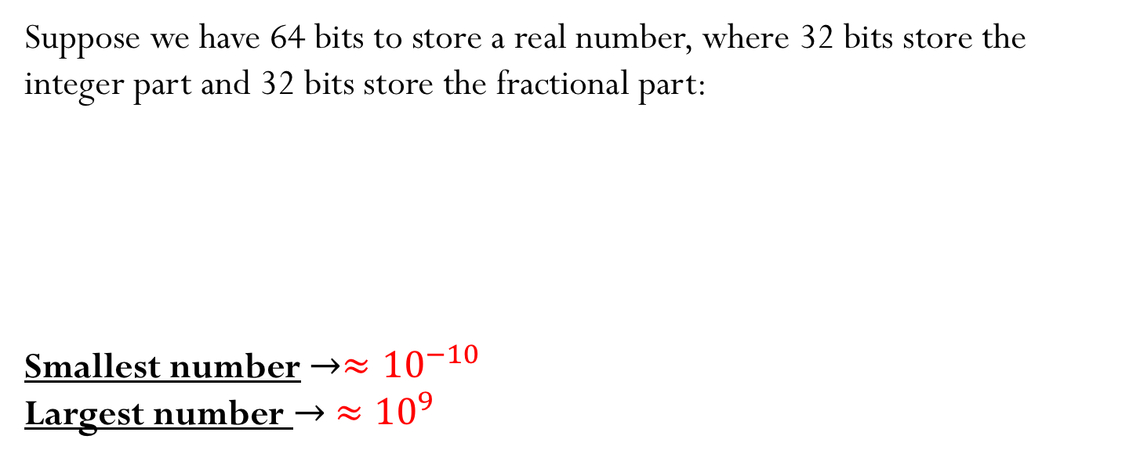

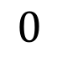
(Unsigned) Fixed-point representation
Suppose we have 64 bits to store a real number, where 32 bits store the integer part and 32 bits store the fractional part:
Smallest number $→≈{10}^{−10}$
Largest number $→ ≈{10}^{9}$
$${\left(a_{31}…a_{2}a_{1}a_{0}.b_{1}b_{2}b_{3}…b_{32}\right)}_{2}=\sum_{k=0}^{31}{a_{k}{ 2}^{k}}+\sum_{k=1}^{32}{b_{k}{ 2}^{−k}}$$
$$0$$
$$∞$$

Slide 5
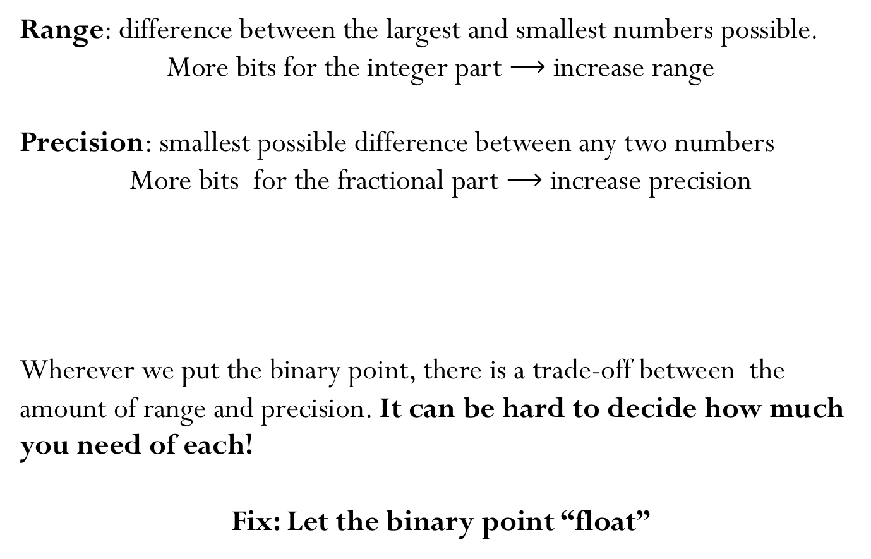
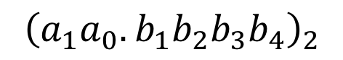
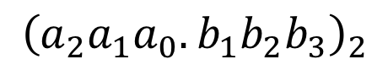
(Unsigned) Fixed-point representation
Range: difference between the largest and smallest numbers possible.
More bits for the integer part $⟶$ increase range
Precision: smallest possible difference between any two numbers
More bits for the fractional part $⟶$ increase precision
Wherever we put the binary point, there is a trade-off between the amount of range and precision. It can be hard to decide how much you need of each!
Fix: Let the binary point “float”
$${\left(a_{2}a_{1}a_{0}.b_{1}b_{2}b_{3}\right)}_{2}$$
OR
$${\left(a_{1}a_{0}.b_{1}b_{2}b_{3}b_{4}\right)}_{2}$$

Slide 6
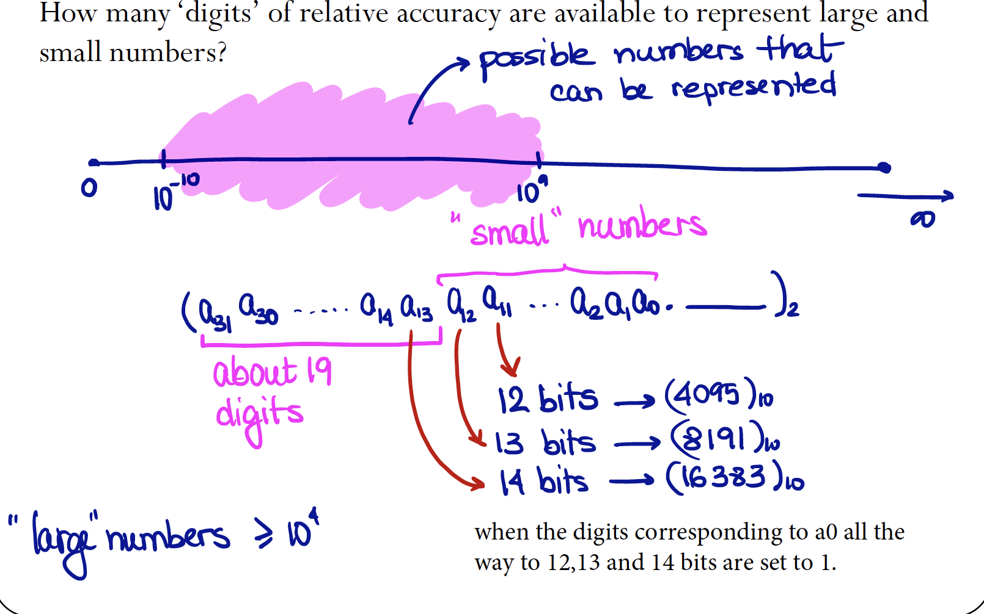

Slide 7
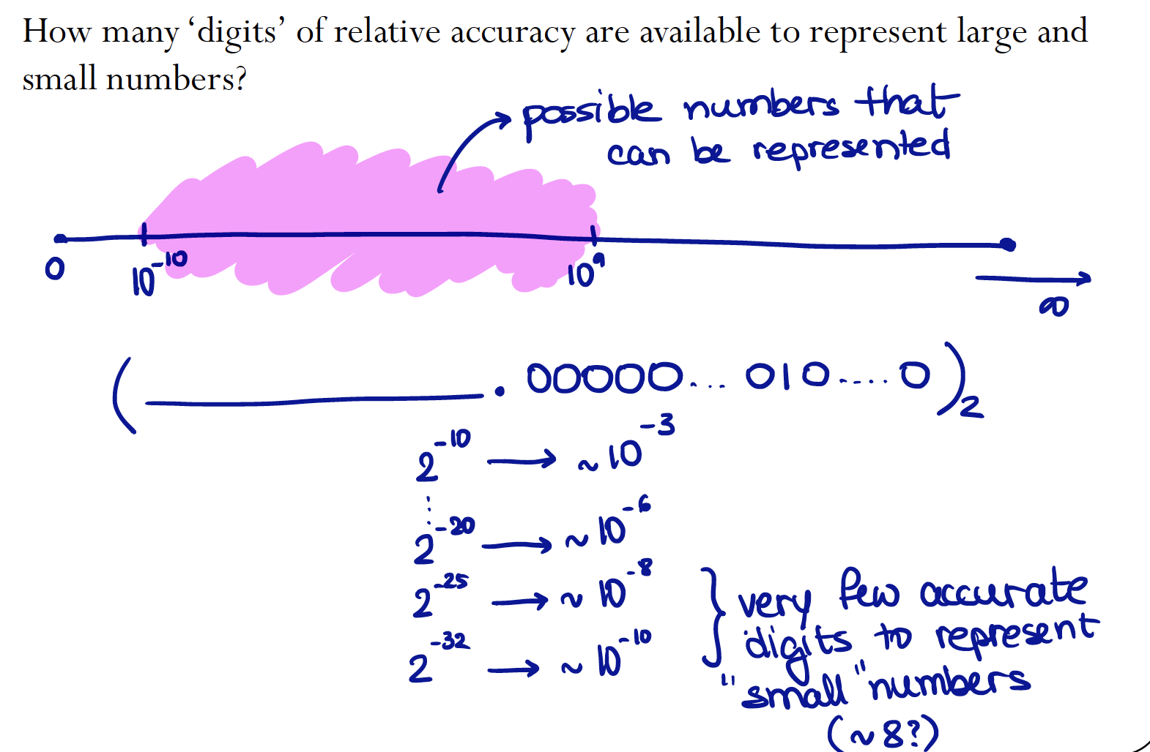

Slide 8
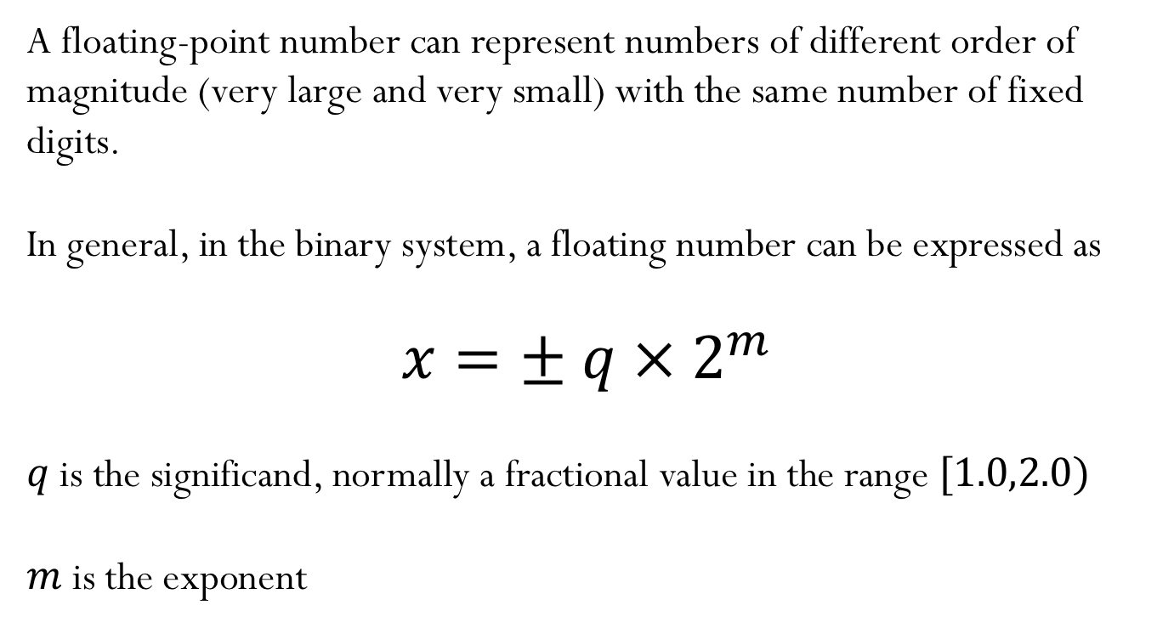
Floating-point numbers
A floating-point number can represent numbers of different order of magnitude (very large and very small) with the same number of fixed digits.
In general, in the binary system, a floating number can be expressed as
$$x=± q ×{ 2}^{m}$$
$q$is the significand, normally a fractional value in the range $[1.0,2.0)$
$m$ is the exponent

Slide 9
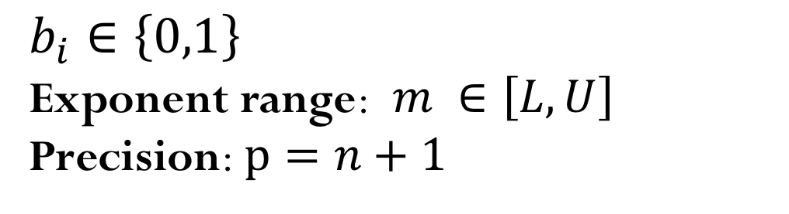
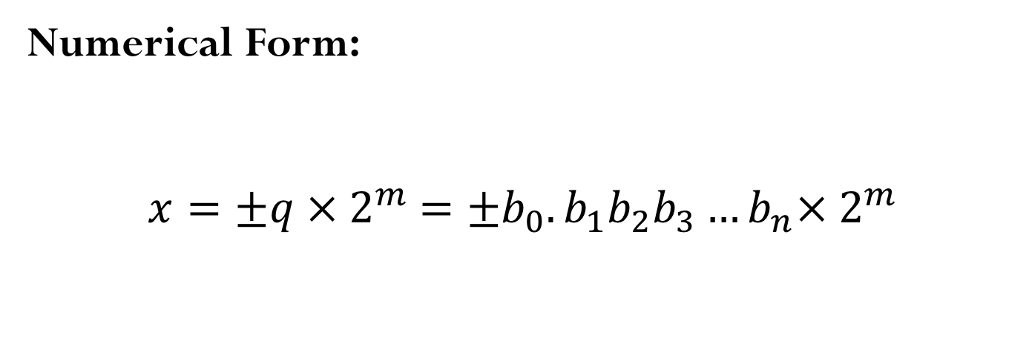
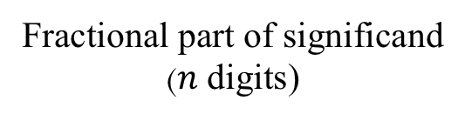
Floating-point numbers
Numerical Form:
$$x=±q ×{ 2}^{m} =±b_{0}.b_{1}b_{2}b_{3}…b_{n}×{ 2}^{m}$$
Fractional part of significand
($n$ digits)
$$b_{i}∈\left\{0,1\right\}$$
Exponent range:$m ∈\left[L,U\right]$
Precision: $p=n+1$

Slide 10
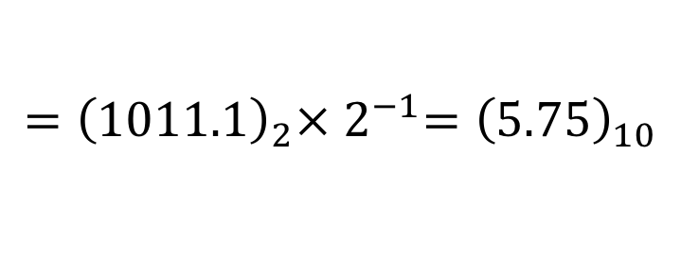
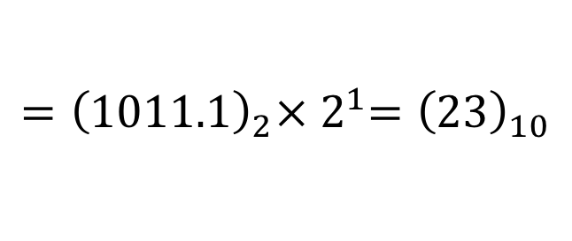
“Floating” the binary point
$${\left(1011.1\right)}_{2}=1×8+0×4+1×2+1×1+1×\frac{1}{2}={\left(11.5\right)}_{10}$$
$${\left(10111\right)}_{2}=1×16+0×8+1×4+1×2+1×1={\left(23\right)}_{10}$$
$${=\left(1011.1\right)}_{2}×{ 2}^{1}={\left(23\right)}_{10}$$
$${\left(101.11\right)}_{2}=1×4+0×2+1×1+1×\frac{1}{2}+1×\frac{1}{4}={\left(5.75\right)}_{10}$$
$${=\left(1011.1\right)}_{2}×{ 2}^{−1}={\left(5.75\right)}_{10}$$
Move “binary point” to the left by one bit position: Divide the decimal number by 2
Move “binary point” to the right by one bit position: Multiply the decimal number by 2

Slide 11
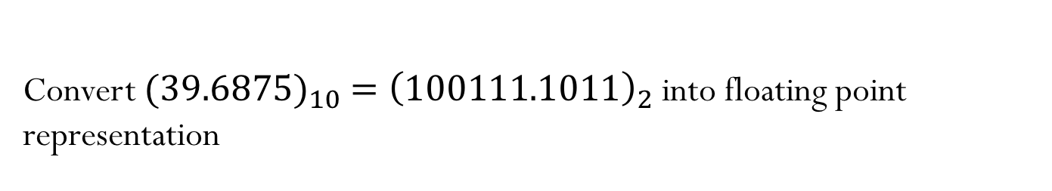
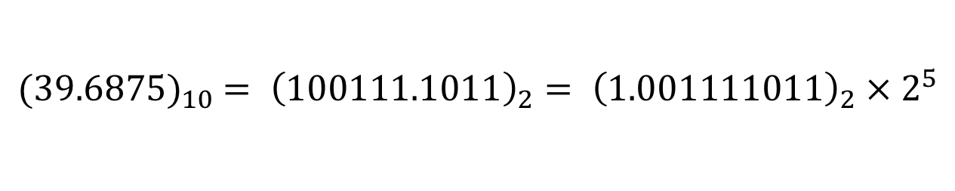
Converting floating points
Convert ${{(39.6875)}_{10} =\left(100111.1011\right)}_{2}$ into floating point representation
$${{(39.6875)}_{10} = \left(100111.1011\right)}_{2}{= \left(1.001111011\right)}_{2} × 2^{5}$$

Slide 12
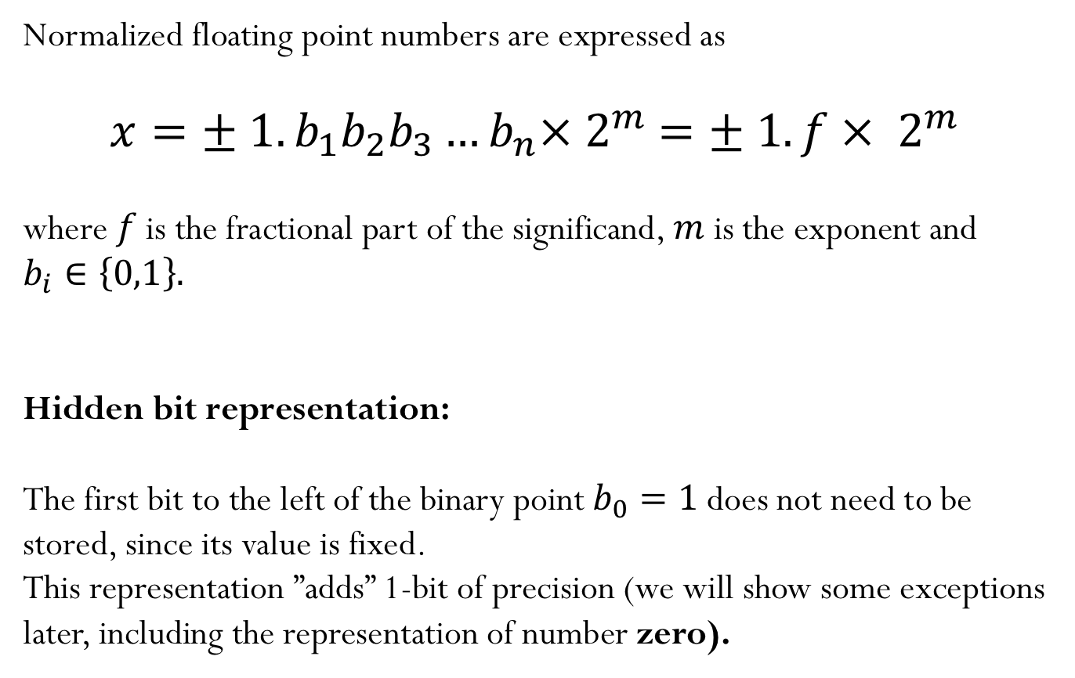
Normalized floating-point numbers
Normalized floating point numbers are expressed as
$$x=± 1.b_{1}b_{2}b_{3}…b_{n}×{ 2}^{m} =± 1.f ×{ 2}^{m}$$
where $f$ is the fractional part of the significand, $m$ is the exponent and $b_{i}∈\left\{0,1\right\}.$
Hidden bit representation:
The first bit to the left of the binary point $b_{0}=1$ does not need to be stored, since its value is fixed.
This representation ”adds” 1-bit of precision (we will show some exceptions later, including the representation of number zero).

Slide 13
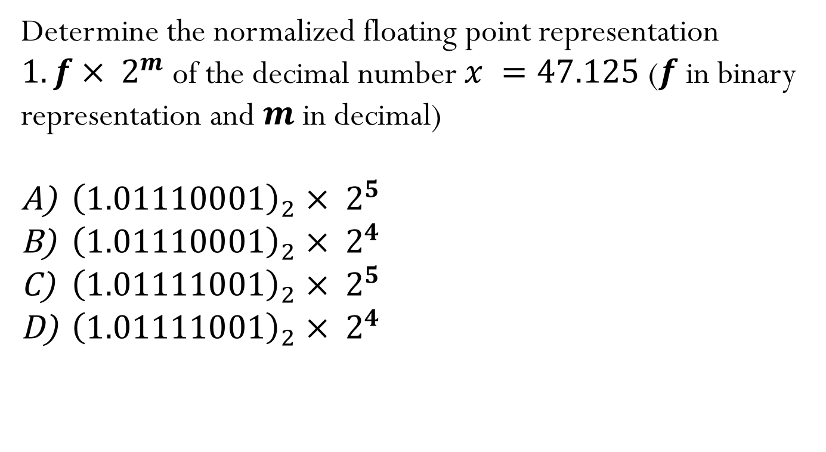
Iclicker question
Determine the normalized floating point representation $1.f ×{ 2}^{m}$of the decimal number $x =47.125$ ($f$ in binary representation and $m$ in decimal)
${\left(1.01110001\right)}_{2} ×{ 2}^{5}$
${\left(1.01110001\right)}_{2} ×{ 2}^{4}$
${\left(1.01111001\right)}_{2} ×{ 2}^{5}$
${\left(1.01111001\right)}_{2} ×{ 2}^{4}$
Notes:
C

Slide 14
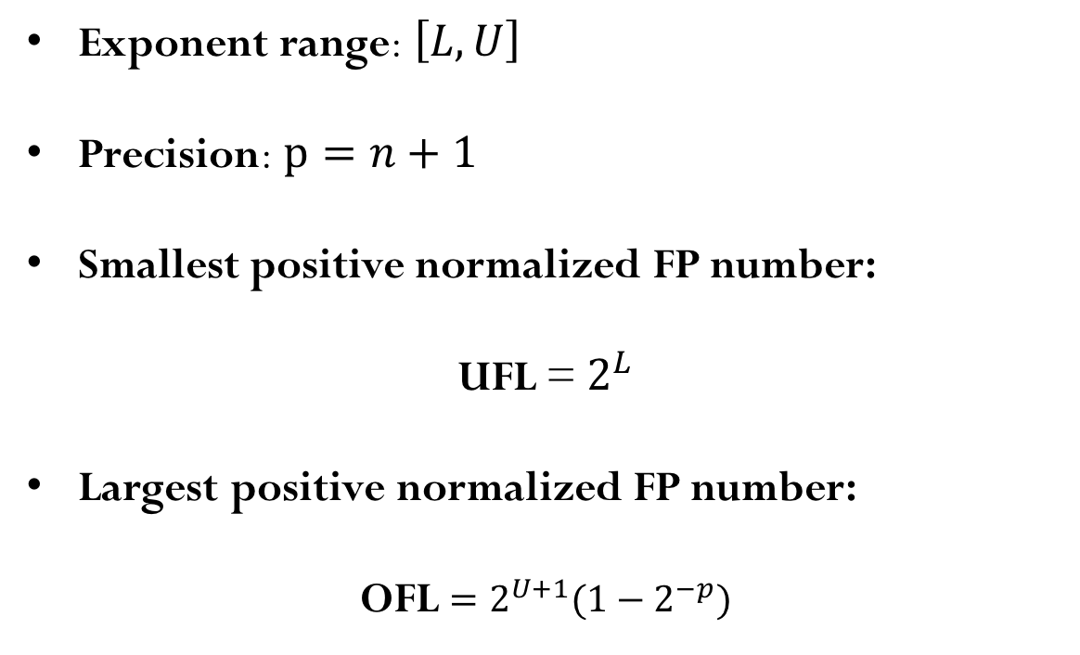
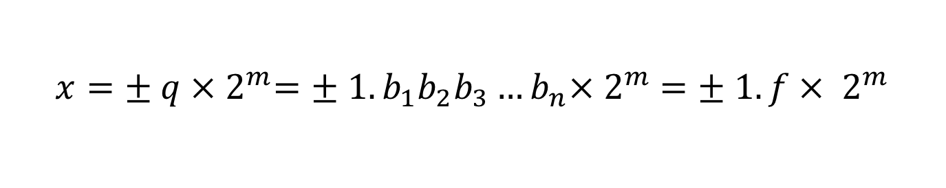
Normalized floating-point numbers
$$x=± q ×{ 2}^{m}=± 1.b_{1}b_{2}b_{3}…b_{n}×{ 2}^{m} =± 1.f ×{ 2}^{m}$$
Exponent range: $\left[L,U\right]$
Precision: $p=n+1$
Smallest positive normalized FP number:
UFL = $2^{L}$
Largest positive normalized FP number:
OFL ${=2^{U+1}(1−2}^{−p})$
Notes:
Note that The value UFL and OFL depend on the exponent range

Slide 15
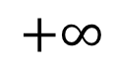
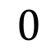
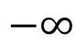
Normalized floating point number scale
$$−∞$$
$$+∞$$
$$0$$

Slide 16
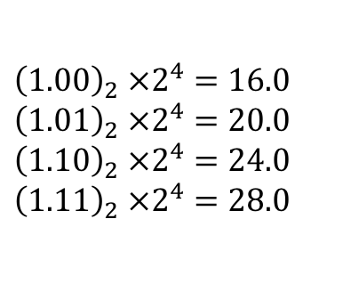
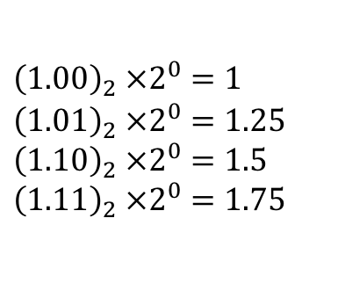
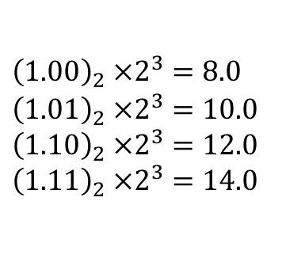
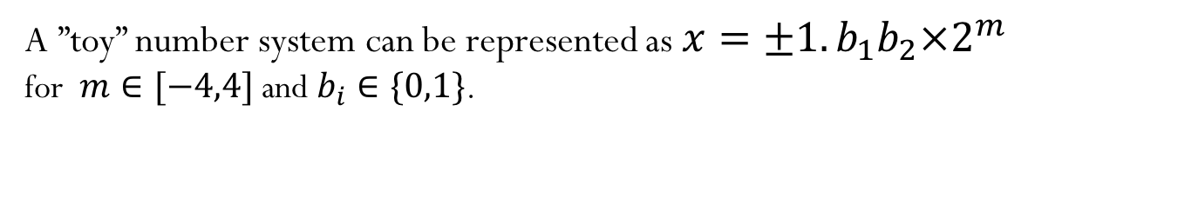
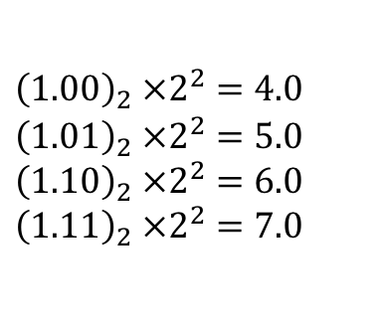
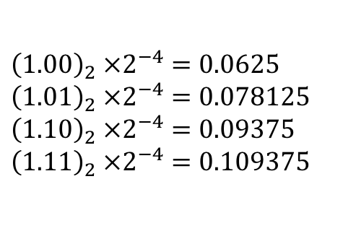
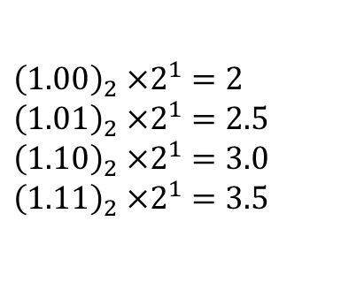
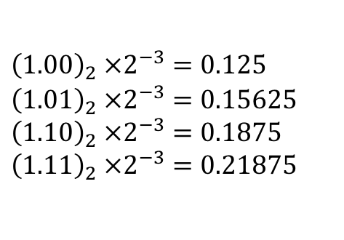
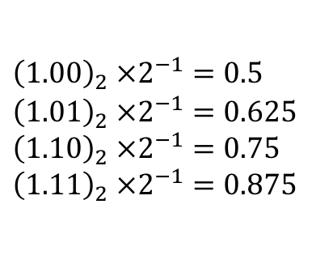
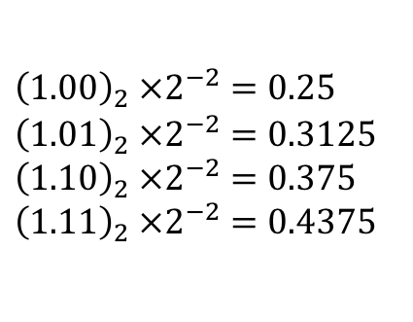
Floating-point numbers: Simple example
A ”toy” number system can be represented as $x=±1.b_{1}b_{2}×2^{m}$
for $m∈[−4,4]$ and $b_{i}∈\{0,1\}$.
$${\left(1.00\right)}_{2} ×2^{0}=1$$
$${\left(1.01\right)}_{2} ×2^{0}=1.25$$
$${\left(1.10\right)}_{2} ×2^{0}=1.5$$
$${\left(1.11\right)}_{2} ×2^{0}=1.75$$
$${\left(1.00\right)}_{2} ×2^{1}=2$$
$${\left(1.01\right)}_{2} ×2^{1}=2.5$$
$${\left(1.10\right)}_{2} ×2^{1}=3.0$$
$${\left(1.11\right)}_{2} ×2^{1}=3.5$$
$${\left(1.00\right)}_{2} ×2^{2}=4.0$$
$${\left(1.01\right)}_{2} ×2^{2}=5.0$$
$${\left(1.10\right)}_{2} ×2^{2}=6.0$$
$${\left(1.11\right)}_{2} ×2^{2}=7.0$$
$${\left(1.00\right)}_{2} ×2^{3}=8.0$$
$${\left(1.01\right)}_{2} ×2^{3}=10.0$$
$${\left(1.10\right)}_{2} ×2^{3}=12.0$$
$${\left(1.11\right)}_{2} ×2^{3}=14.0$$
$${\left(1.00\right)}_{2} ×2^{4}=16.0$$
$${\left(1.01\right)}_{2} ×2^{4}=20.0$$
$${\left(1.10\right)}_{2} ×2^{4}=24.0$$
$${\left(1.11\right)}_{2} ×2^{4}=28.0$$
$${\left(1.00\right)}_{2} ×2^{−1}=0.5$$
$${\left(1.01\right)}_{2} ×2^{−1}=0.625$$
$${\left(1.10\right)}_{2} ×2^{−1}=0.75$$
$${\left(1.11\right)}_{2} ×2^{−1}=0.875$$
$${\left(1.00\right)}_{2} ×2^{−2}=0.25$$
$${\left(1.01\right)}_{2} ×2^{−2}=0.3125$$
$${\left(1.10\right)}_{2} ×2^{−2}=0.375$$
$${\left(1.11\right)}_{2} ×2^{−2}=0.4375$$
$${\left(1.00\right)}_{2} ×2^{−3}=0.125$$
$${\left(1.01\right)}_{2} ×2^{−3}=0.15625$$
$${\left(1.10\right)}_{2} ×2^{−3}=0.1875$$
$${\left(1.11\right)}_{2} ×2^{−3}=0.21875$$
$${\left(1.00\right)}_{2} ×2^{−4}=0.0625$$
$${\left(1.01\right)}_{2} ×2^{−4}=0.078125$$
$${\left(1.10\right)}_{2} ×2^{−4}=0.09375$$
$${\left(1.11\right)}_{2} ×2^{−4}=0.109375$$
Same steps are performed to obtain the negative numbers. For simplicity, we will show only the positive numbers in this example.

Slide 17
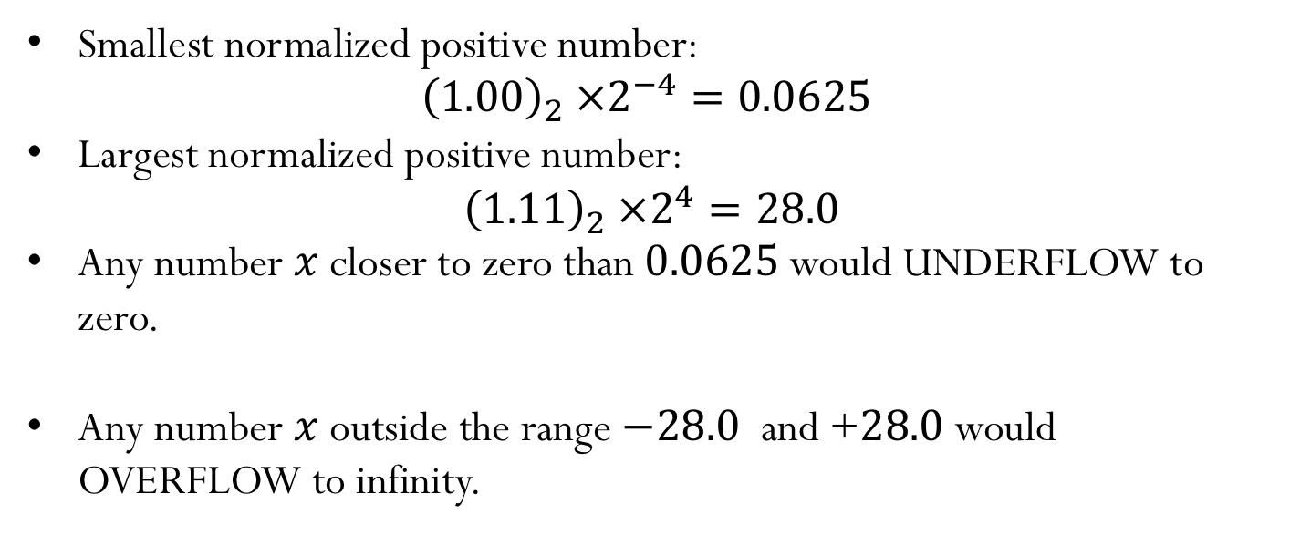
$x=±1.b_{1}b_{2}×2^{m}$ for $m∈[−4,4]$ and $b_{i}∈\{0,1\}$
Smallest normalized positive number:
$${\left(1.00\right)}_{2} ×2^{−4}=0.0625$$
Largest normalized positive number:
$${\left(1.11\right)}_{2} ×2^{4}=28.0$$
Any number $x$closer to zero than $0.0625$would UNDERFLOW to zero.
Any number $x$outside the range $−28.0$and +$28.0$would OVERFLOW to infinity.
Notes:
There are some other definitions for machine epsilon, which give ½ times this number, but we will not discuss them, or use them in this class. You can check textbook and online references if you want to read more about machine epsilon

Slide 18
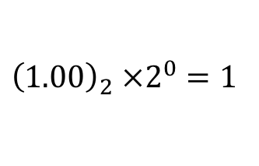
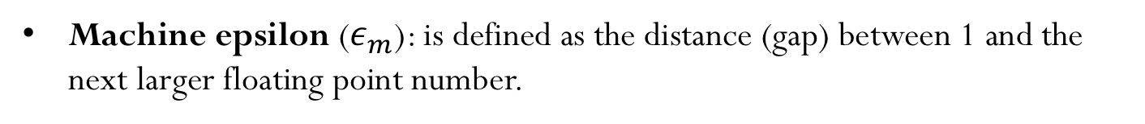
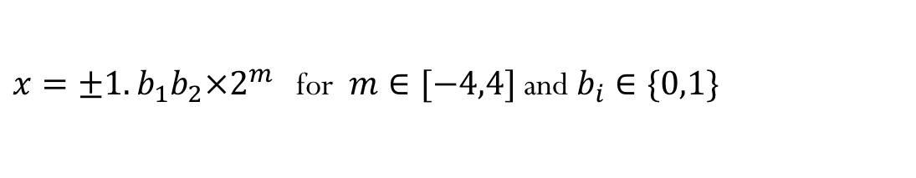
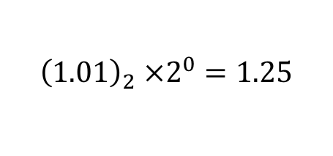

Machine epsilon
Machine epsilon ($ε_{m}$): is defined as the distance (gap) between 1 and the next larger floating point number.
$x=±1.b_{1}b_{2}×2^{m}$ for $m∈[−4,4]$ and $b_{i}∈\{0,1\}$
${\left(1.00\right)}_{2} ×2^{0}=1$
$${\left(1.01\right)}_{2} ×2^{0}=1.25$$
$$ε_{m}={\left(0.01\right)}_{2} ×2^{0}=0.25$$
Notes:
There are some other definitions for machine epsilon, which give ½ times this number, but we will not discuss them, or use them in this class. You can check textbook and online references if you want to read more about machine epsilon.
The value of machine epsilon does not depend on the exponent range, but instead it depends on the number of digits on the significand

Slide 19
Machine numbers: how floating point numbers are stored?

Slide 20





Floating-point number representation
What do we need to store when representing floating point numbers in a computer?
$$x =± 1.f ×{ 2}^{m}$$
$$x=$$
$$±$$
$$m$$
$$f$$
sign
exponent
significand
Initially, different floating-point representations were used in computers, generating inconsistent program behavior across different machines.
Around 1980s, computer manufacturers started adopting a standard representation for floating-point number: IEEE (Institute of Electrical and Electronics Engineers) 754 Standard.

Slide 21







Floating-point number representation
Numerical form:
$$x =± 1.f ×{ 2}^{m}$$
Representation in memory:
$$x=$$
$$s$$
$$c$$
$$f$$
sign
exponent
significand
$$x ={(−1)}^{s} 1.f ×{ 2}^{c−shift}$$
$$m=c−shift$$

Slide 22








Precisions:
Finite representation: not all numbers can be represented exactly!
IEEE-754 Single precision (32 bits):
$$x=$$
$$s$$
$$c=m+127$$
$$f$$
sign (1-bit)
exponent
(8-bit)
significand
(23-bit)
IEEE-754 Double precision (64 bits):
$$x=$$
$$s$$
$$c=m+1023$$
$$f$$
sign (1-bit)
exponent
(11-bit)
significand
(52-bit)

Slide 23

















Special Values:
$$x ={(−1)}^{s} 1.f ×{ 2}^{m} =$$
$$s$$
$$c$$
$$f$$
1) Zero:
$$x=$$
$$s$$
$$000…000$$
$$0000……0000$$
2) Infinity: $+∞$($s=0)$ and $−∞ \left(s=1\right)$
$$x=$$
$$s$$
$$111…111$$
$$0000……0000$$
3) NaN: (results from operations with undefined results)
$$x=$$
$$s$$
$$111…111$$
$$anything ≠00…00$$
Note that the exponent $c=\left(000…000\right)$and $c=\left(111…111\right)$ are reserved for these special cases, which limits the exponent range for the other numbers.

Slide 24





IEEE-754 Single Precision (32-bit)
$$x ={(−1)}^{s} 1.f ×{ 2}^{m}$$
$$s$$
$$c=m+127$$
$$f$$
sign (1-bit)
exponent
(8-bit)
significand
(23-bit)
$s=0:$positive sign, $s=1:$negative sign
Reserved exponent number for special cases:
${c=\left(11111111\right)}_{2}=255$ and ${c=\left(00000000\right)}_{2}=0$
Therefore $0<c<255$
The largest exponent is $U=254−127=127$
The smallest exponent is $L=1−127=−126$
Notes:
Store the shifted exponent c = m + 127, so that the sign of the exponent does not need to be stored (exponent can be stored in 8 bits instead of 7).

Slide 25






IEEE-754 Single Precision (32-bit)
$$x ={(−1)}^{s} 1.f ×{ 2}^{m}$$
Example: Represent the number $x=−67.125$ using IEEE Single-Precision Standard
$${67.125= \left(1000011.001\right)}_{2}={ \left(1.000011001\right)}_{2}×2^{6}$$
$$c=6+127=133{=\left(10000101\right)}_{2}$$
$$1$$
$$10000101$$
$$00001100100000…000$$
1-bit
8-bit
23-bit

Slide 26











IEEE-754 Single Precision (32-bit)
$$x ={(−1)}^{s} 1.f ×{ 2}^{m} =$$
$$s$$
$$c$$
$$f$$
$$c=m+127$$
Machine epsilon ($ε_{m}$): is defined as the distance (gap) between 1 and the next larger floating point number.
$${\left(1\right)}_{10}=$$
$$0$$
$$01111111$$
$$00000000000000000000000$$
$${\left(1\right)}_{10}+ε_{m}=$$
$$0$$
$$01111111$$
$$00000000000000000000001$$
$$ε_{m}=2^{−23}≈1.2 ×{ 10}^{−7}$$
Smallest positive normalized FP number:
UFL = $2^{L}=2^{−126}≈1.2 ×{10}^{−38}$
Largest positive normalized FP number:
OFL ${=2^{U+1}(1−2}^{−p})$ ${=2^{128}(1−2}^{−24})≈3.4 ×{10}^{38}$
Notes:
Because of machine epsilon, we infer that in a simple computation, approximately six sig figs of accuracy may be obtained in single precision

Slide 27




IEEE-754 Double Precision (64-bit)
$$x ={(−1)}^{s} 1.f ×{ 2}^{m}$$
$$s$$
$$c=m+1023$$
$$f$$
sign (1-bit)
exponent
(11-bit)
significand
(52-bit)
$s=0:$positive sign, $s=1:$negative sign
Reserved exponent number for special cases:
${c=\left(11111111111\right)}_{2}=2047$ and ${c=\left(00000000000\right)}_{2}=0$
Therefore $0<c<2047$
The largest exponent is $U=2046−1023=1023$
The smallest exponent is $L=1−1023=−1022$

Slide 28





IEEE-754 Double Precision (64-bit)
$$x ={(−1)}^{s} 1.f ×{ 2}^{m} =$$
$$s$$
$$c$$
$$f$$
$$c=m+1023$$
Machine epsilon ($ε_{m}$): is defined as the distance (gap) between 1 and the next larger floating point number.
$${\left(1\right)}_{10}=$$
$$0$$
$$0111…111$$
$$000000000000…000000000$$
$${\left(1\right)}_{10}+ε_{m}=$$
$$0$$
$$0111…111$$
$$000000000000…000000001$$
$$ε_{m}=2^{−52}≈2.2 ×{ 10}^{−16}$$
Smallest positive normalized FP number:
UFL = $2^{L}=2^{−1022}≈2.2 ×{10}^{−308}$
Largest positive normalized FP number:
OFL ${=2^{U+1}(1−2}^{−p})$ ${=2^{1024}(1−2}^{−53})≈1.8 ×{10}^{308}$
Notes:
Because of machine epsilon, we infer that in a simple computation, approximately six sig figs of accuracy may be obtained in single precision

Slide 29
Normalized floating point number scale (double precision)
$$−∞$$
$$+∞$$
$$0$$

Slide 30






Subnormal (or denormalized) numbers
Noticeable gap around zero, present in any floating system, due to normalization
The smallest possible significand is $1.00$
The smallest possible exponent is $L$
Relax the requirement of normalization, and allow the leading digit to be zero, only when the exponent is at its minimum ($m=L$)
Computations with subnormal numbers are often slow.
Representation in memory (another special case):
Numerical value:
$$x=$$
$$s$$
$$c=000…000$$
$$f$$
Note that this is a special case, and the exponent $m$ is not evaluated as $m=c−shift=−shift.$
Instead, the exponent is set to the lower bound, $m=L$
$${ x =(−1)}^{s} 0.f ×{ 2}^{L}$$
Notes:
Why would you want to know about subnormals? Because
computing with them is often slow, because it is implemented
using ‘FP assist’, i.e. not in actual hardware. Many C compilers
support options to ‘flush subnormals to zero’.
Lost of precision when using subnormal numbers
Computations with subnormal numbers are often slow: Subtraction of two non-equal numbers never produces a result of exactly zero.
the smallest gap between two consecutive normalized floating-point number is ϵm⋅UFL, which is the smallest positive subnormal number. This means subtracting two non-equal number will be at least the smallest subnormal number, so it will never produces a result of 0.

Slide 31


Subnormal (or denormalized) numbers
IEEE-754 Single precision (32 bits):
${c=\left(00000000\right)}_{2}=0$
Exponent set to $m=−126$
Smallest positive subnormal FP number: $2^{−23} ×{ 2}^{−126} ≈1.4 ×{10}^{−45}$
IEEE-754 Double precision (64 bits):
${c=\left(00000000000\right)}_{2}=0$
Exponent set to $m=−1022$
Smallest positive subnormal FP number: $2^{−52} ×{ 2}^{−1022} ≈4.9 ×{10}^{−324}$
Allows for more gradual underflow to zero (however subnormal numbers don’t have as many accurate digits as normalized numbers)
Notes:
Why would you want to know about subnormals? Because
computing with them is often slow, because it is implemented
using ‘FP assist’, i.e. not in actual hardware. Many C compilers
support options to ‘flush subnormals to zero’.
Lost of precision when using subnormal numbers

Slide 32
IEEE-754 Double Precision

Slide 33





Summary for Single Precision
$$x ={(−1)}^{s} 1.f ×{ 2}^{m} =$$
$$s$$
$$c$$
$$f$$
$$m=c−127$$
Stored binary exponent $(c)$ | Significand fraction $(f)$ | value
00000000 | 0000…0000 | zero
00000000 | $any f≠0$ | $${(−1)}^{s} 0.f ×{ 2}^{−126}$$
00000001 | $$any f$$ | $${(−1)}^{s} 1.f ×{ 2}^{−126}$$
11111110 | $$any f$$ | $${(−1)}^{s} 1.f ×{ 2}^{127}$$
11111111 | $$any f≠0$$ | NaN
11111111 | 0000…0000 | infinity
$$⋮$$
$$⋮$$
$$⋮$$

Slide 34







Example
Determine the single-precision representation of the decimal number $x =37.625$
Convert the decimal number to binary: ${\left(37.625 \right)}_{10}={\left(100101.101 \right)}_{2}$
 | $$2^{5}$$ | $$2^{4}$$ | $$2^{3}$$ | $$2^{2}$$ | $$2^{1}$$ | $$2^{0}$$ | $$2^{−1}$$ | $$2^{−2}$$ | $$2^{−3}$$
 | 32 | 16 | 8 | 4 | 2 | 1 | 0.5 | 0.25 | 0.125
# | 1 | 0 | 0 | 1 | 0 | 1 | 1 | 0 | 1
37.625 | 5.625 | 5.625 | 5.625 | 1.625 | 1.625 | 0.625 | 0.125 | 0.125 | 0
Convert the binary number to the normalized FP representation $1.f ×{ 2}^{m}$
$${\left(100101.101 \right)}_{2}={\left(1.00101101 \right)}_{2}×2^{5}$$
$$s=0$$
$$f=00101101…00$$
$$m=5$$
$$c=m+127=132={\left(10000100\right)}_{2}$$
$0 10000100$ $00101101000000000000000$

Slide 35
What is the equivalent decimal number?
$0 00000000$ $00000000000000000000000$
$1 11111111$ $00000000000000000000000$
$0 11111111$ $11111111110000111111111$
$0 00000000$ $11110000000000000000000$
$0 01111111$ $00000000000000000000000$

Slide 36

Iclicker question
A number system can be represented as $x=±1.b_{1}b_{2}b_{3}×2^{m}$
for $m∈[−5,5]$ and $b_{i}∈\{0,1\}$.
What is the smallest positive normalized FP number:
a) 0.0625 b) 0.09375 c) 0.03125 d) 0.046875 e) 0.125
What is the largest positive normalized FP number:
a) 28 b) 60 c) 56 d) 32
How many additional numbers (positive and negative) can be represented when using subnormal representation?
a) 7 b) 14 c) 3 d) 6 e) 16
What is the smallest positive subnormal number?
a) 0.00390625 b) 0.00195313 c) 0.03125 d) 0.0136719
Determine machine epsilon
a) 0.0625 b) 0.00390625 c) 0.0117188 d) 0.125

Slide 37

A number system can be represented as $x=±1.b_{1}b_{2}b_{3}b_{4}×2^{m}$
for $m∈[−6,6]$ and $b_{i}∈\{0,1\}$.
Let’s say you want to represent the decimal number $19.625$ using the binary number system above. Can you represent this number exactly?
What is the range of integer numbers that you can represent exactly using this binary system?

Slide 38

Iclicker question
Determine the decimal number corresponding to the following single-precision machine number:
$1 10011001$ $00000000000000000000001$
A) $67,108,872$
B) $−67,108,872$
C) $67,108,864$
D) $−67,108,864$
Notes:
B

Slide 39

Iclicker question
Determine the double-precision machine representation of the decimal number $x =−37.625$
A)
B)
C)
D)
$1 10000100000$ $00101101000000…0$
$1 10000000100$ $00101101000000…0$
$0 10000100000$ $00101101000000…0$
$0 10000000100$ $00101101000000…0$
(52-bit)
Notes:
100101.101 = 1.00101101 x 2^(5)
M=5 => c=(1028)_{10} = (10000000100)_2
B)

